Slide 1
Characterize | Company Name: Chiony Power | Title: EPEAT PD 45W Noise Issue
 | Champion: CF Liu Date: 2020/6/26 | Description: 6/17 KS Compal feedback that they got 1pc Dell EPEAT PD 45W defect from their field the defective symptom is noise. 7/3 Compal got another defect with similar symptom Dell P/N: 6KDC9/ P07C8 (EPEAT, E5 SSF PD45W white/Black) PPID: CN06KDC9CH20001G01O4 CN0P07C8CH200049012E D/C: 01G(Jan.2020) 049(Apr.2020)
 | Members: CQS: Candy Zhu SQE: Wendy IPQC/QE: Chaes Cai IE: Yansong Tong MFG: Allison Wang PE: Plain Chen Sales: Steve RD: Hunter
Contain | Containment Actions: Stop using the source of Holy stone immediately. P/N: 26KKX210SUW3LF Owner: RD/Benson QE/Chase Implement date: 7/6

Slide 2
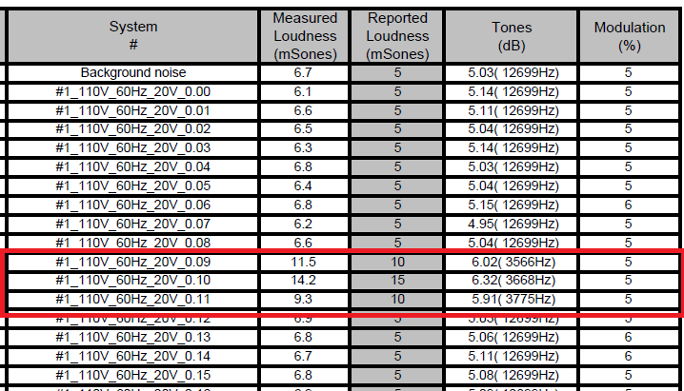
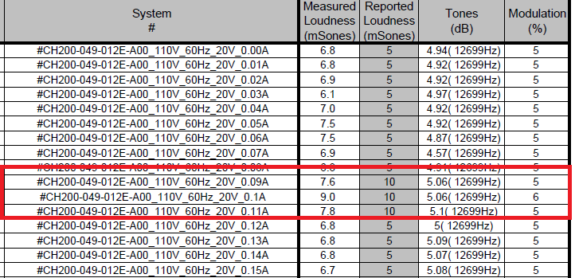
Cause | FA and Root Cause: 1. Check the production record , no abnormality was found. 2. Listening the defect together with 3pcs fresh adapters at a quiet environment, we find it has buzzing sound if put our ear on the adapter under 110v voltage, 0~full load. But there is no obvious abnormality between the returned sample and fresh adapters. 3. Test the Acoustic of returned samples together with 3pcs fresh adapters in third party, the result is the returned samples have louder sound then other adapters under the conduction of 110v voltage _0.1A but it is still pass DELL Acoustic spec. Returned samples test result:

Slide 3
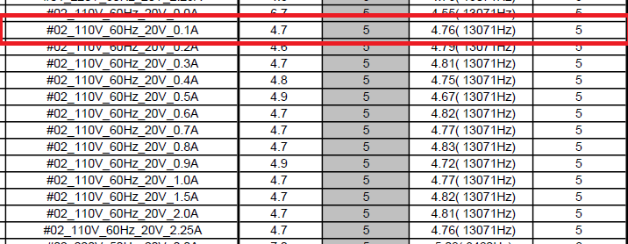
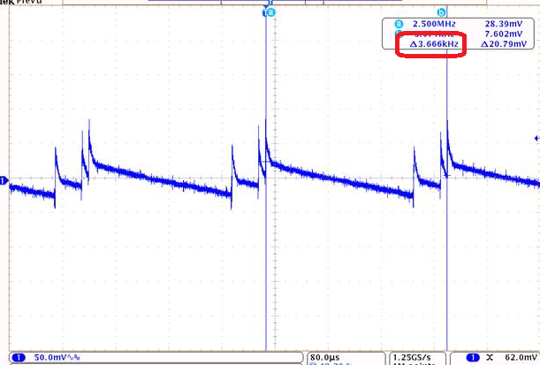
Cause | FA and Root Cause: Fresh samples test result: 4. Base on the above test data, we get that the worst condition is at 0.1A and audible noise frequency is 3.668KHz. Check output ripple noise frequency is same with audible noise frequency (3.668KHz).

Slide 4
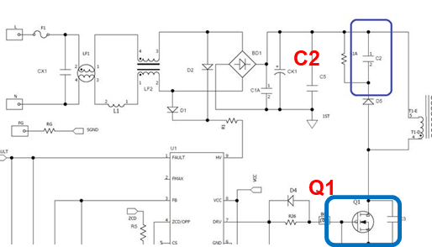
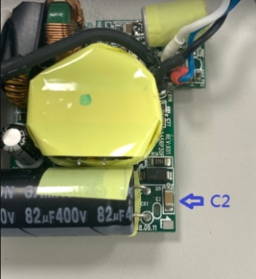
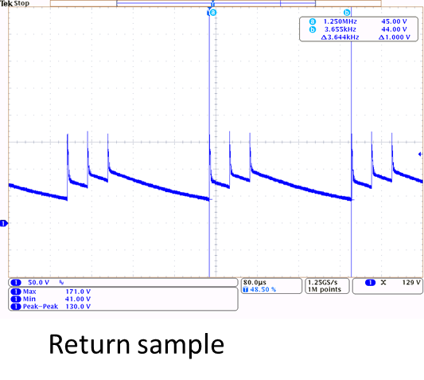
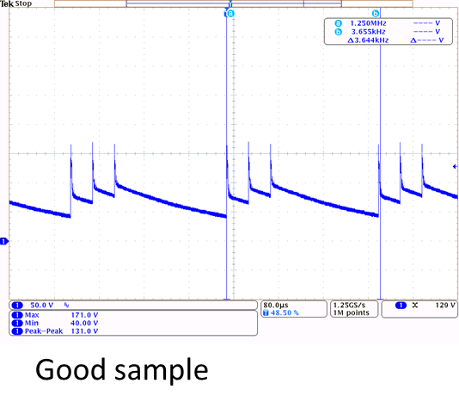
Cause | FA and Root Cause: 5. Open the case and continue listening we find noise comes from snubber cap (C2, Vendor: HOLY STONE) Check the circuit C2 is used as an RCD buffer to suppress the MOSFET(Q1) voltage. 6. To measure the wave form of C2 of returned sample, the worst condition is at 0.1A and audible noise frequency is 3.6KHz which is matched with the test result of adapter.

Slide 5
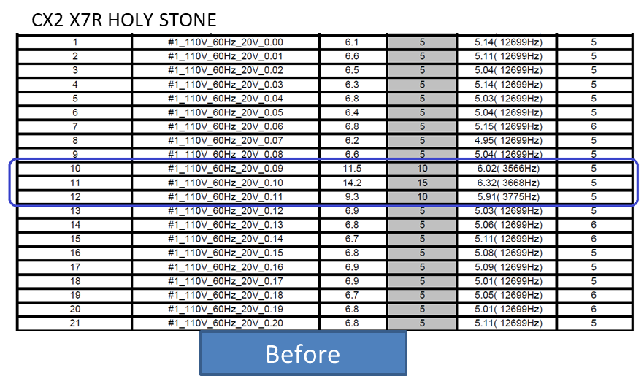
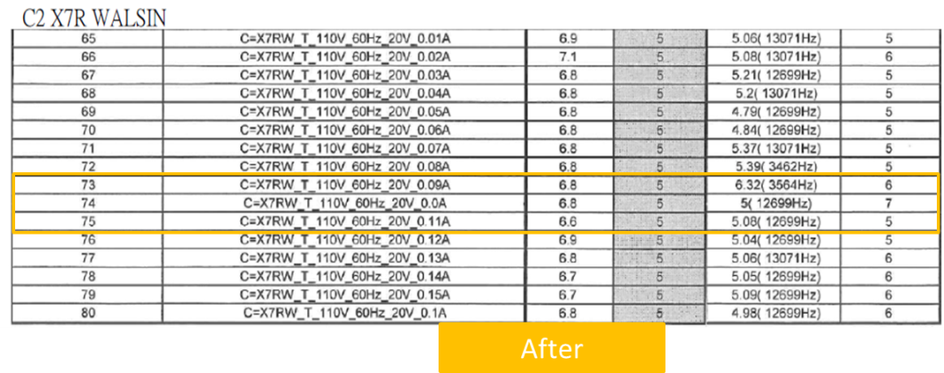
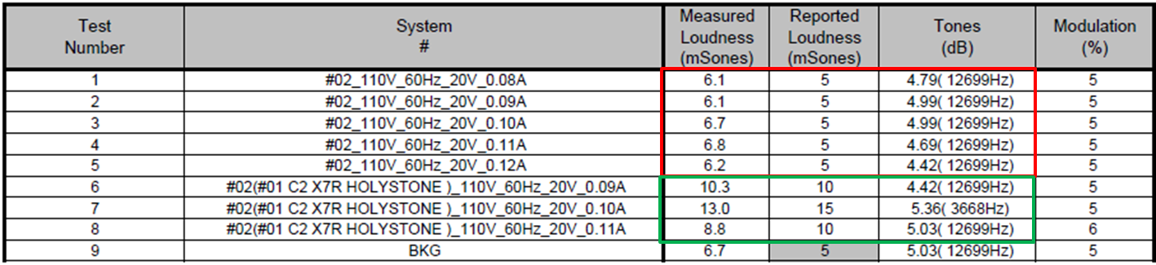

Cause | FA and Root Cause: 7. Then we change the C2 to another source(WALSIN) of the BOM and re-test , the noise can be improved more, test result please refer to below: 8. Solder the C2 (Holy stone) of returned sample to a good sample then test the acoustic, the noise become worst than before.(need pic)

Slide 6
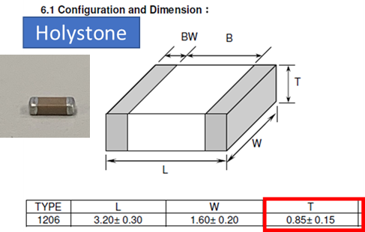
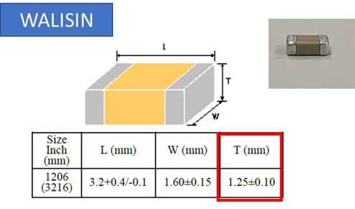
Cause | FA and Root Cause: 9. Base on the above analysis we can get below conclusions: 9.1 the noise comes form C2 the MLCC cap. 9.2 As X7R type cap the Source Holystone create higher noise than Walsin. Why the MLCC cap can make the noise: The principle of noise generation is MLCC’s vibration makes Substrate vibrate, when its vibration freq. comes to “Acoustic Freq. (20Hz to 20kHz)” range then we can hear vibration as “Acoustic Noise”. And due to X7R type cap is made of ferroelectric dielectrics and this type cap will produce significant noise howling under the effect of a large AC electric field strength. Why Source Holystone create higher noise than Walsin. The component of Walsin’s is thicker than Holystone’s. The thicker of MLCC, the less impact on PCB vibration and the lower noise.

Slide 7
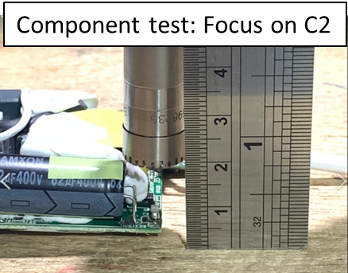
Cause | FA and Root Cause: 10. We also measured the thickness of another cap of NPO type and the result please refer to below: 11. Random pick some NPO type cap of different vendor then do component test and adapter test, the result is the performance of NPO type cap is better than X7R type cap no matter in component test or in adapter acoustic test.

Slide 8
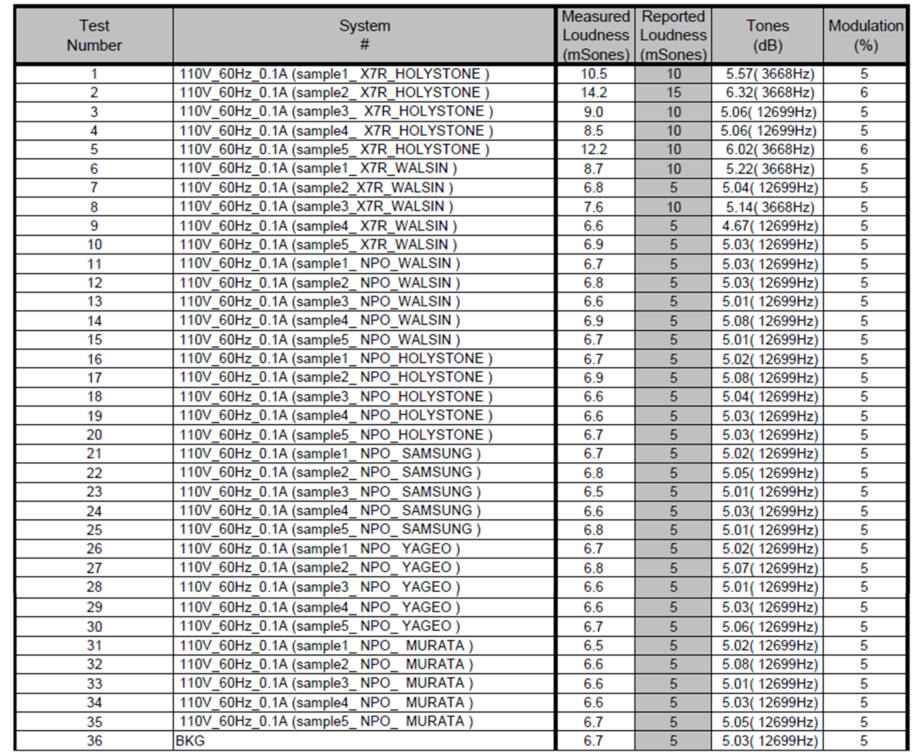
Cause | 2. Take 5pcs MLCC by vendor and material type, used in one same adapter then do adapter acoustic test, result please refer to below:

Slide 9
Cause | Conclusion: Base on the above test the worst condition is at 0.1A and audible noise frequency is 3.668KHz. The noise comes form C2 the MLCC cap. 3. As X7R type cap the Source Holystone create higher noise than Walsin. 4. The noise performance of NPO type MLCC is much better than X7R type MLCC. Risk Assessment: Even the noise of returned samples are worst than the normal product but they are still pass DELL spec. So the risk is low.

Slide 10
Correction | Corrective Actions: 1. Stop using the source of Holy stone immediately. P/N: 26KKX210SUW3LF Owner: RD/Benson QE/Chase Implement date: 7/6 2. Plan to use NPO type cap instead of X7R type cap for this location , will submit the ECR to DELL by 7/28. Owner: RD/Benson Due date: 7/28
 | Preventive Action: List this issue into design LL that must use NPO type cap for future design for snubber cap location Owner: RD/Benson Date: 7/16
Closure | Prepared by: Candy/Benson Date: 2020. 7. 17(update) Reviewed by: CF/Hunter Date: 2020.7.17 Approved by: Date:

